Slide 1
W11 - Survey
Cryptographic splitting & Homomorphic encryption
20221115 Meeting

Slide 2
Content
Telehealth Scenarios
廖苡辰
秦宗佑
Cryptographic splitting
羅寶瑩
王靖婷
張麒仙
Homomorphic encryption
蔡佳誠
霍芷媛
張麒仙

Slide 3
Telehealth Scenarios
廖苡辰

Slide 4
遠距醫療應用
慢性病居家照護（如：血壓、血糖監測）
長照
視訊看診、開藥：for 偏鄉醫療、隔離者

Slide 5
長照
衛福部豐原醫院與台積電慈善基金會、台灣受恩公司合作，在獨居老人家中建置「遠距關懷系統」， 導入智慧藥盒、健康手環、視訊系統與室內定位感測器，照護團隊能夠即時掌握長者的生理數值、用藥情形與活動狀態，輔以視訊關懷，讓長者能在家安老。

Slide 6
民眾返家照護管理APP
慢性病
糖尿病患者可藉由手機上傳個人的血糖值、用藥紀錄與飲食狀況，讓醫事團隊能遠端掌握資料，線上提供諮詢與個人化的照護建議。

Slide 7
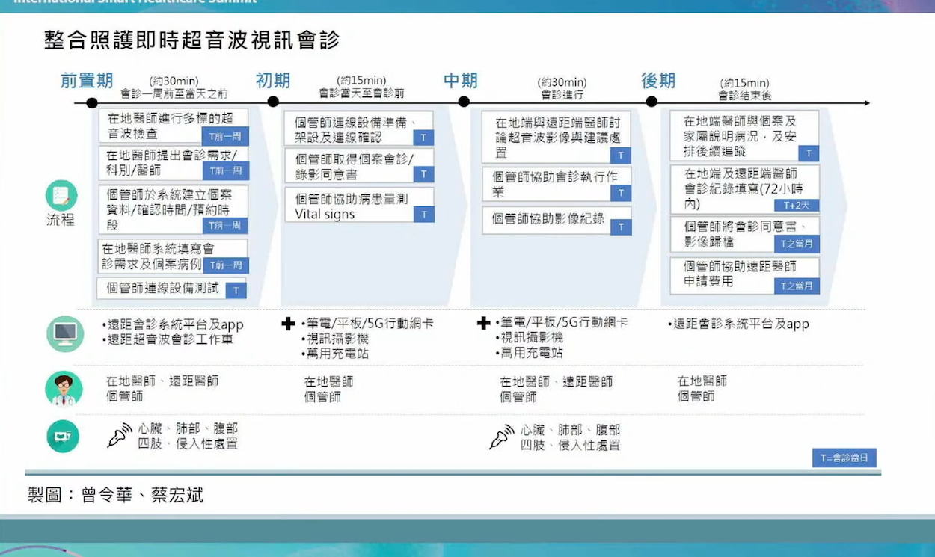
偏鄉醫療
Ex 台東都蘭診所
1.由行動醫療車提供多種檢查儀器，如超音波、心電圖、內視鏡等，來即時提供病患和家屬檢測結果和衛教。
2.與醫學中心的醫師遠距會診

Slide 8
台大醫院新竹分院與交通大學生物科技研究所柯立偉教授目前正在合作開發攜帶式的運動心電圖結合智慧型手機的心臟復健APP

Slide 9
Reference
遠距醫療不只線上看診，遠端照護、長照...5大應用報你知 - 療日子健康新聞
https://www.healingdaily.com.tw/articles/%E9%81%A0%E8%B7%9D%E9%86%AB%E7%99%82-%E6%96%B0%E8%81%9E%E5%A0%B1%E5%B0%8E/

Slide 10
Telehealth Scenarios
秦宗佑

Slide 12
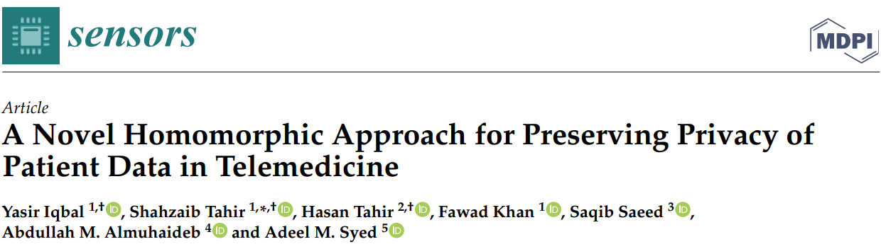

Slide 13
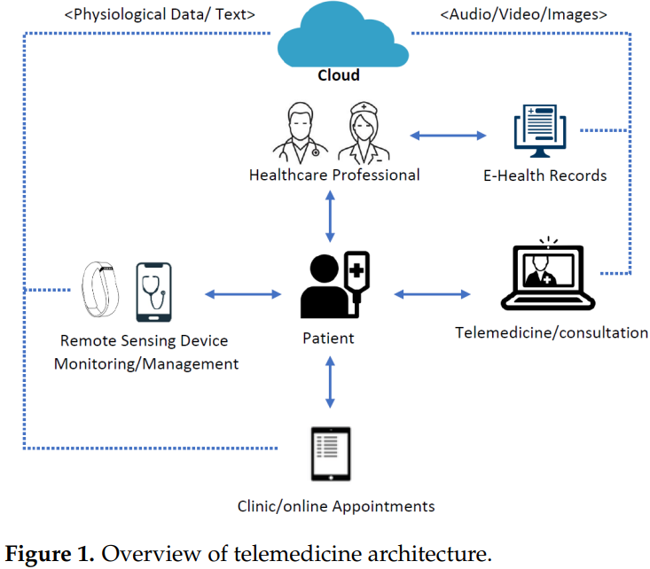
Intro
The surge in the adoption of cloud computing in the telehealth sector raises many security and privacy challenges.
As per the report, there was a 40.63% increase in data breaches of healthcare records in February 2021.
A patient died due to a ransomware cyberattack in Germany that disrupted the hospital facility system.

Slide 14

Major Types of Attacks Against Telehealth Systems
Compromise of Confidentiality
Theft of PHI or PII
Credential harvesting
Data exfiltration
Compromise of Integrity
Exploitation of financial transaction system
Manipulation of clinical data
Compromise of Availability
Ransomware
Denial of Service

Slide 15
Design Goals
Data confidentiality— the conventional mechanism for achieving confidentiality is storing data in encrypted form. Therefore, data must be confidential before uploading to the cloud.
Searching capability— there is a need for a mechanism to search over the cloud without decryption, and a need for retrieving or downloading only the desired file.
Authorized person searching— only the authorized person who has keys should generate the trapdoor and search requests.
Privacy-preserving— while sending the search query request to the server, the adversary should not know any information about the query. The trapdoor should be probabilistic, so the ciphertext will differ each time the request is made.
Search pattern hiding— the outcome of the searching should be probabilistic, such that a keyword being searched repeatedly should be indistinguishable, hence hiding the search pattern.
Cloud deployable— the searchable encryption scheme should be deployable in a client– server architecture using any cloud service, and it should be able to integrate into an existing enterprise network.

Slide 16
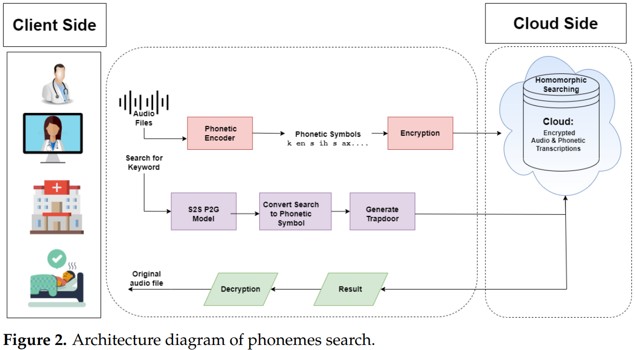
System model
The proposed system searches phonemes over encrypted audio files.
First, the audio file is passed through the encoder to generate its phonemes.
The client encrypts the audio files in phonemic form and sends them to the server.
The client also generates the trapdoor, the desired searching phonemes, and sends it to the server.
The server then calculates homomorphically over encrypted phonemes and finds matched audio file(s) w/o decryption.
The server then sends the searched results to the client.
The client receives the file and decrypts it.
The original file, consisting of phonemes, can be found after decrypting it.

Slide 17
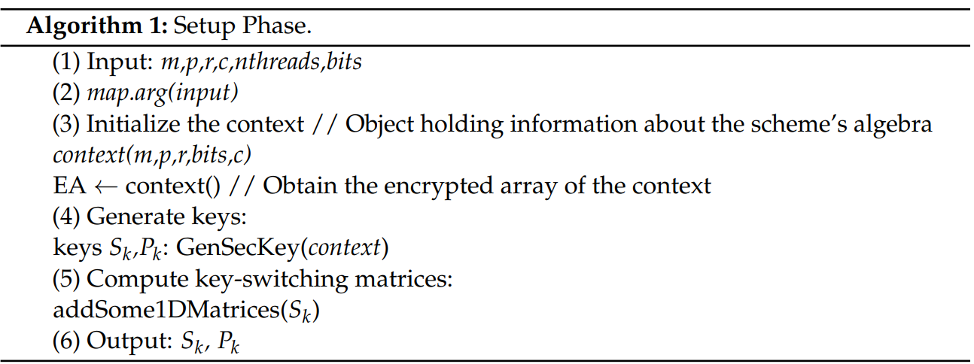
Setup phase

Slide 18
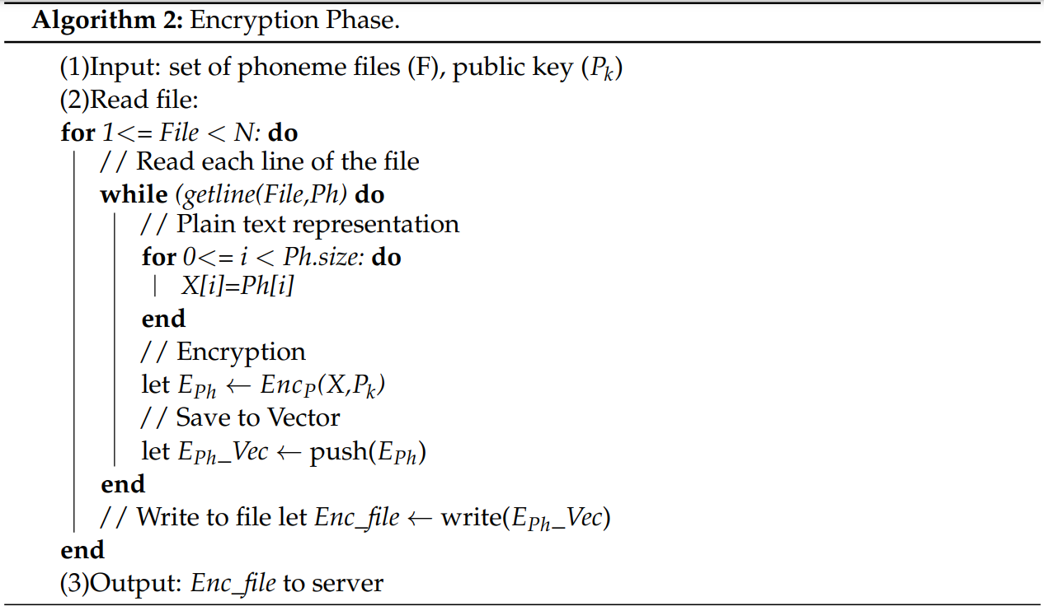
Encryption phase

Slide 19
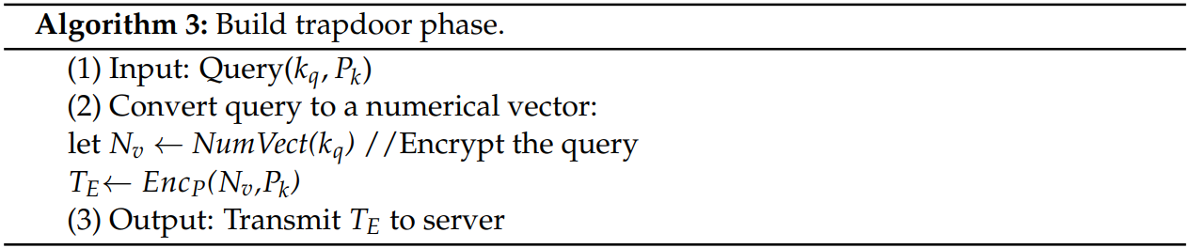
Build Trapdoor Phase

Slide 20
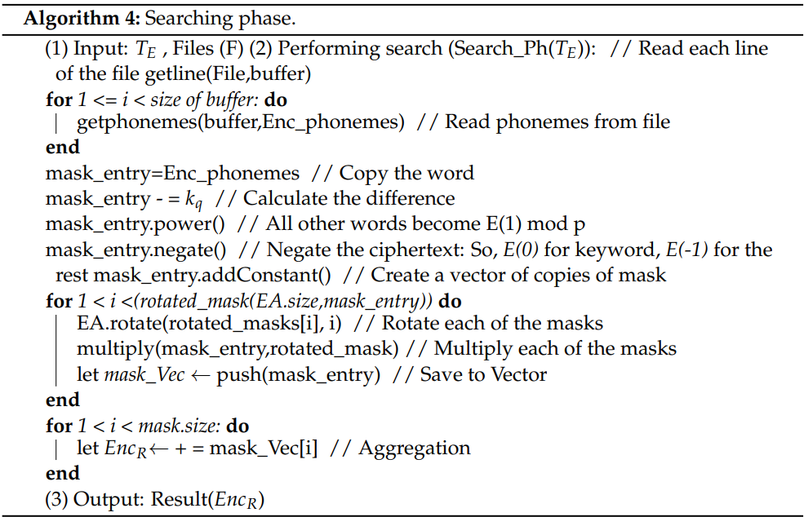
Searching Phase

Slide 21
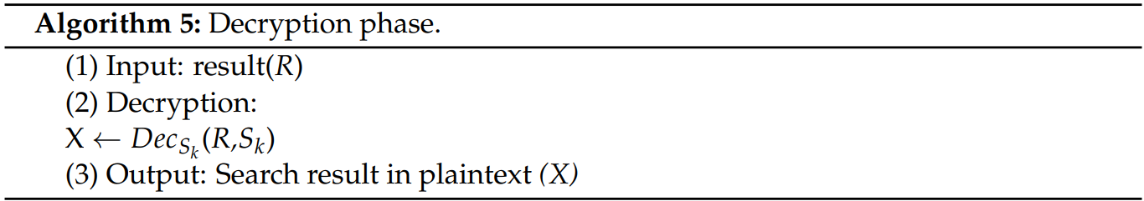
Decryption Phase

Slide 22
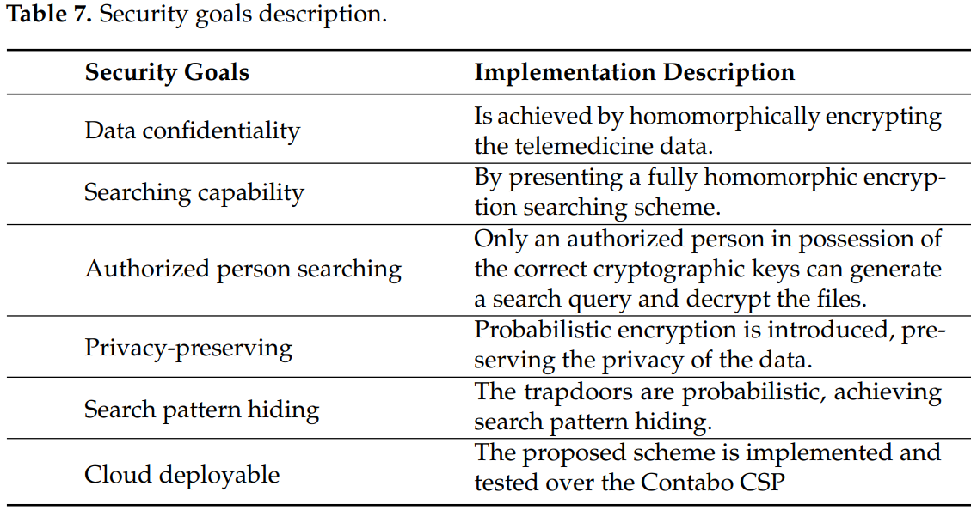
Goal achieving

Slide 23
Conclusions and Future Work
This paper presents a novel method of preserving the privacy of healthcare audio data stored in the cloud using fully HE.
This research focuses on phonemes/audio searching over the cloud w/o decrypting the audio files.
For this purpose, the proposed scheme utilizes a homomorphic encryption library (HElib).
The library is probabilistic encryption with a BGV scheme, achieving data privacy in the cloud while querying the phonemes and probabilistically searching the desired file.
Finally, the implementation of the client–server architecture was performed using multiple audio files while integrating the scheme with the public cloud platform "Contabo".
The analysis shows that the computation time increases with increased security levels.
This research work can be extended through multi-threading to increase the performance speed, using more audio files with high-security levels, and implemented using other open-source libraries, e.g., HEAAN, SEAL, and PALISADE.
The performance can also be increased by using a cloud server with high specifications, automatically scaling up the resources as per the requirements.

Slide 24
Ref
Sensors 2022, 22, 4432. https://doi.org/10.3390/s22124432
HEALTH INDUSTRY CYBERSECURITY - SECURING TELEHEALTH AND TELEMEDICINE. The Health Sector Coordinating Council (HSCC).

Slide 25
Cryptographic splitting
羅寶瑩

Slide 26
Insider Threats and Cryptographic Techniques in Secure Information Management

Slide 27
Introduction
These solutions are based on coding information into a binary form
and then splitting this coded information among a selected group of individuals—secret trustees
each of whom receives a share of the split secret.
In order to reproduce the information, all shares of the split secret must be combined and the information decoded.

Slide 28
Splitting and sharing algorithms
Both data splitting and sharing algorithms divide data between a group of secret trustees
selected at the time the algorithm is defined
is a person or a participant of the data division process
a secret participant holds one of n shares of the divided information (secret) into which information I has been divided

Slide 29
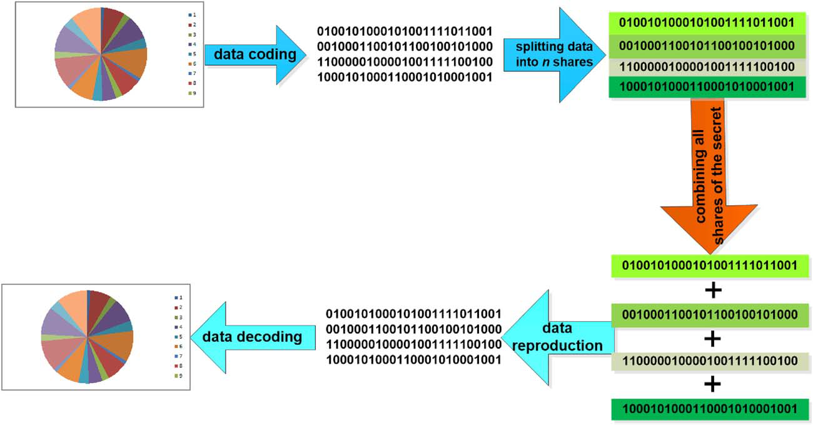
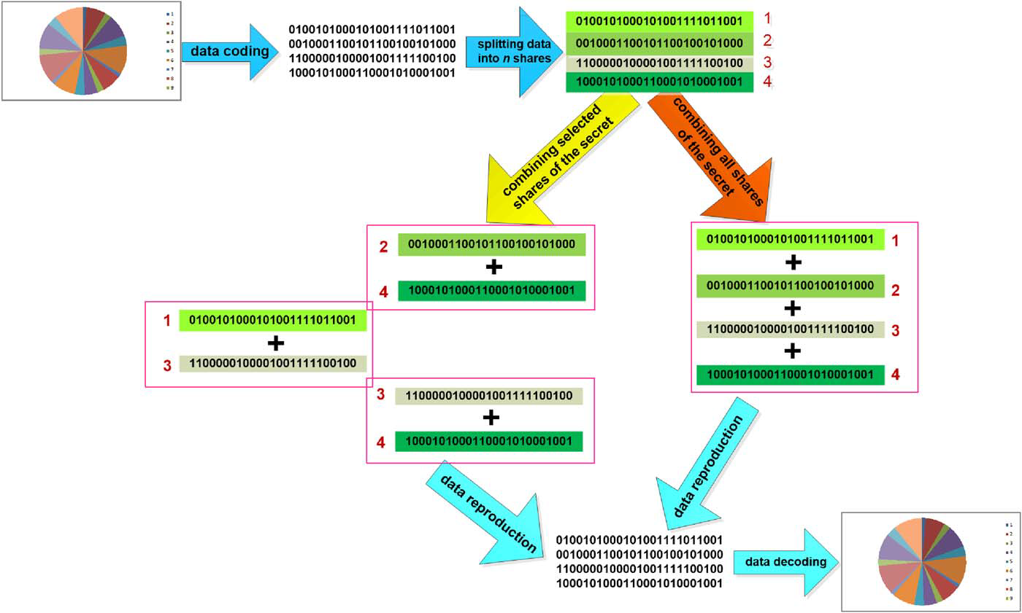
Splitting and sharing algorithms
Data splitting algorithms require combining all n shares of the split secret to reproduce the split information.
Data sharing algorithms require combining a certain number of shares m<n, set at the time of defining the algorithm, to reproduce information I

Slide 30
Cryptographic algorithms
Shamir’s algorithm;
Tang’s algorithm;
Lagrange’s interpolation polynomial algorithm;
Blakley’s vector algorithm;
Karnin–Greene–Hellman algorithm;
Asmuth–Bloom algorithm.

Slide 31
Shamir’s algorithm
using operation of a threshold scheme based on Lagrange’s interpolating polynomial
allows to generate particular number of secret parts with equal accessing grants

Slide 32
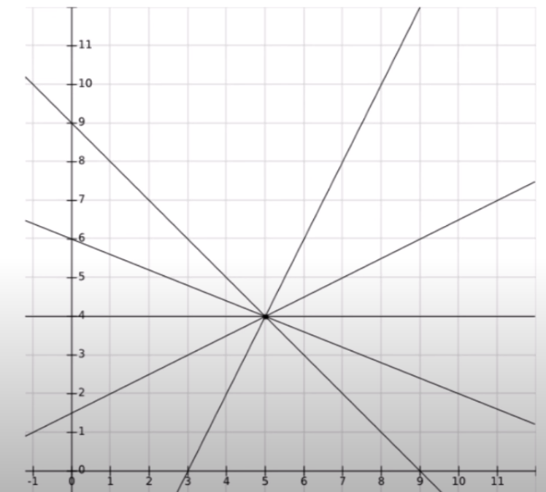
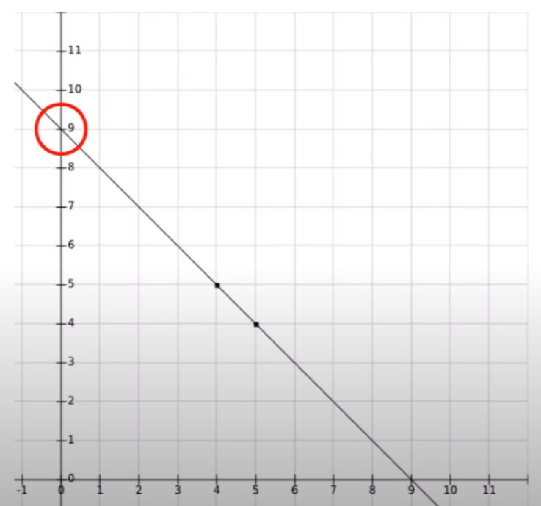
Shamir’s algorithm - straight line
given one point of a line f, f(0) can be anything
given two points of a line f, f(0) can be only one value

Slide 33
Shamir’s algorithm - straight line
Alice wants to split a secret between Bob and Carl
secret = 6
secret line is f(x) = 6 - 0.5x
Send two points, one for Bob [ f(4) = 4 ], one for Carl [ f(8) = 2 ]
Bob and Carl can compute the line and f(0) to find the secret = 6
Therefore, use straight lines to share a secret over n participants
requires more than 1 share to retrieve it.

Slide 34
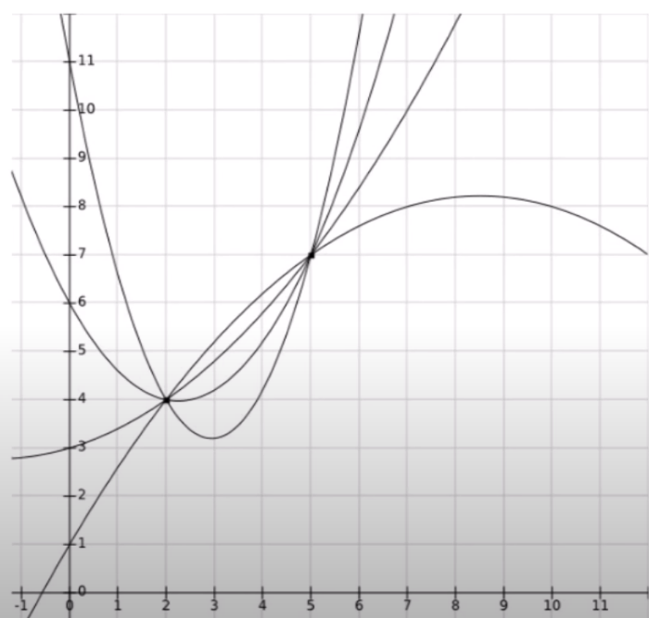
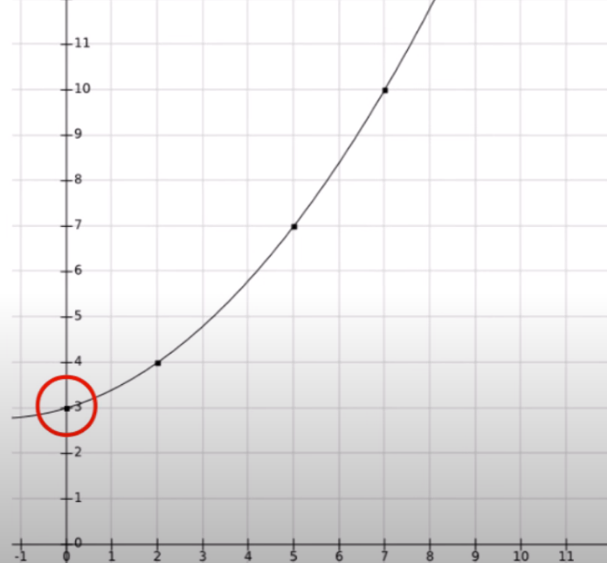
Shamir’s algorithm - quadratic line
How many Quadratic lines go through two points?
How many f(0)?
How many Quadratic lines go through three points?
How many f(0)?
Used quadratic lines to share a secret over n participants:
requires more than 2 shares to retrieve it.

Slide 35
Shamir’s algorithm - polynomial
Polynomial of order | Shares needed | Form
1 | >1 | a₀ + a₁x | Line
2 | >2 | a₀ + a₁x + a₂x² | Quadratic
3 | >3 | a₀ + a₁x + a₂x² + a₃x³
4 | >4 | a₀ + a₁x + a₂x² + a₃x³ + a₄x⁴

Slide 36
Shamir’s algorithm - Summary
splits a secret s into n shares, such that
any combination of <= L shares cannot learn the secret
any combination of > L shares learns the secret
constructs a degree-L polynomial f such that f(0) = s and computes
share₁ = f(1), share₂= f(2), ..., share_{n} = f(n),
For more information, please visit https://youtu.be/kkMps3X_tEE

Slide 37
Tang’s algorithm
using only simple operations of adding sets, which is, at the same time, a completely secure algorithm
allows to generate shares with different accessing grants (with some privileges)

Slide 38
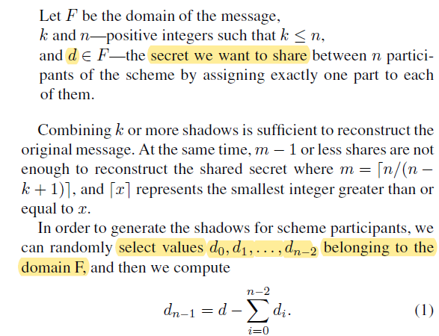
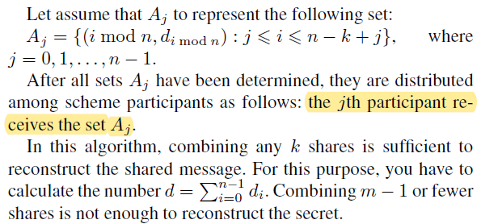
Tang’s algorithm

Slide 39
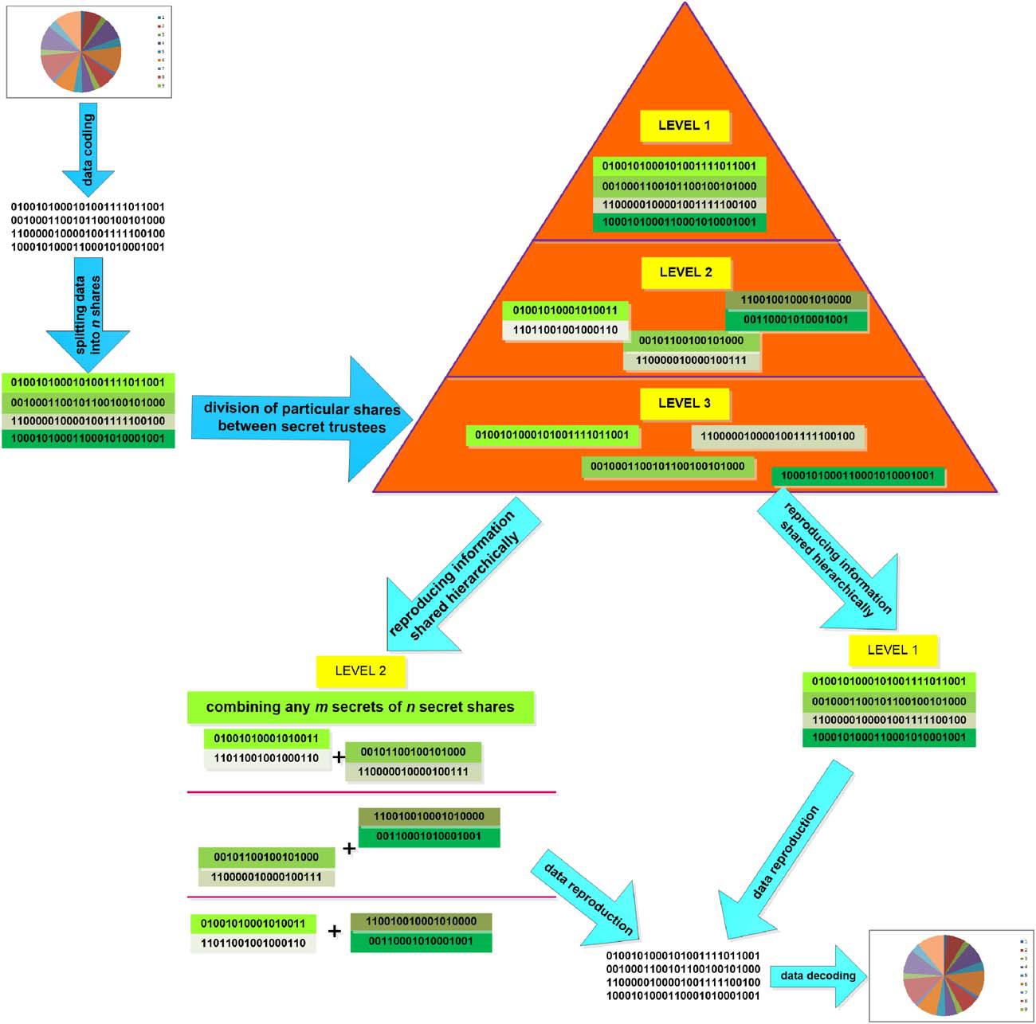
Data sharing scheme in a hierarchical structure
Level 1:
a single person can reproduce the information.
Level 2:
the shared secret is reproduced by two out of three
protocol participants

Slide 40
Enhanced Security for Multi-Cloud Storage using Cryptographic Data Splitting with Dynamic Approach

Slide 41
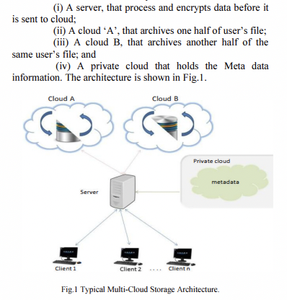
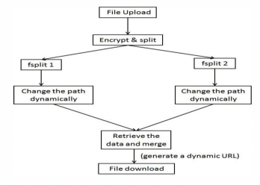

Slide 42
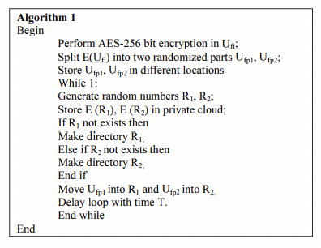
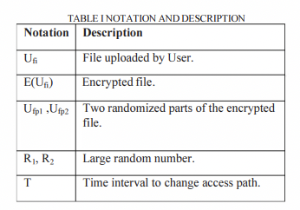

Slide 43
Reference
L. Ogiela and M. R. Ogiela, "Insider Threats and Cryptographic Techniques in Secure Information Management," in IEEE Systems Journal, vol. 11, no. 2, pp. 405-414, June 2017, doi: 10.1109/JSYST.2015.2409213.
Simple introduction to Shamir's Secret Sharing and Lagrange interpolation - https://youtu.be/kkMps3X_tEE

Slide 44
Cryptographic splitting
王靖婷

Slide 45
CQRS: Command Query Responsibility Segregation

Slide 46
會改變系統狀態但不會回傳值的操作，稱之為Command，以及不會改變狀態但會回傳值的操作，稱為Query
Simplicity：CQRS將系統分成Write Model與Read Model，這兩種模型的行為與責任大不相同。從單一責任原則（Single Responsibility Principle；SRP）的角度來看，CQRS進一步簡化不同模型之內的複雜度。
寫入模型：
Strong consistency
normalized data model
one-way dependency
讀取模型：
Eventually consistency
de-normalized data model (materialized view)
any-way dependency
Scalability：很多系統的讀取頻率遠大於寫入，例如在電子商務系統中大部分的使用者都在瀏覽資料，少部分的操作才會改變系統狀態。在這種情況下，套用CQRS可以單獨針對讀取部分加以拓展。
Speed (Performance)：綜合上述兩個優點，CQRS可以提升系統反應速度與效能，因為開發人員可以分別針對寫入端與讀取端採取不同的優化策略。例如，寫入端採取Event Sourcing簡化與加速寫入操作，讀取端因為不會改變狀態，可以用各種快取工具加快讀取。

Slide 47
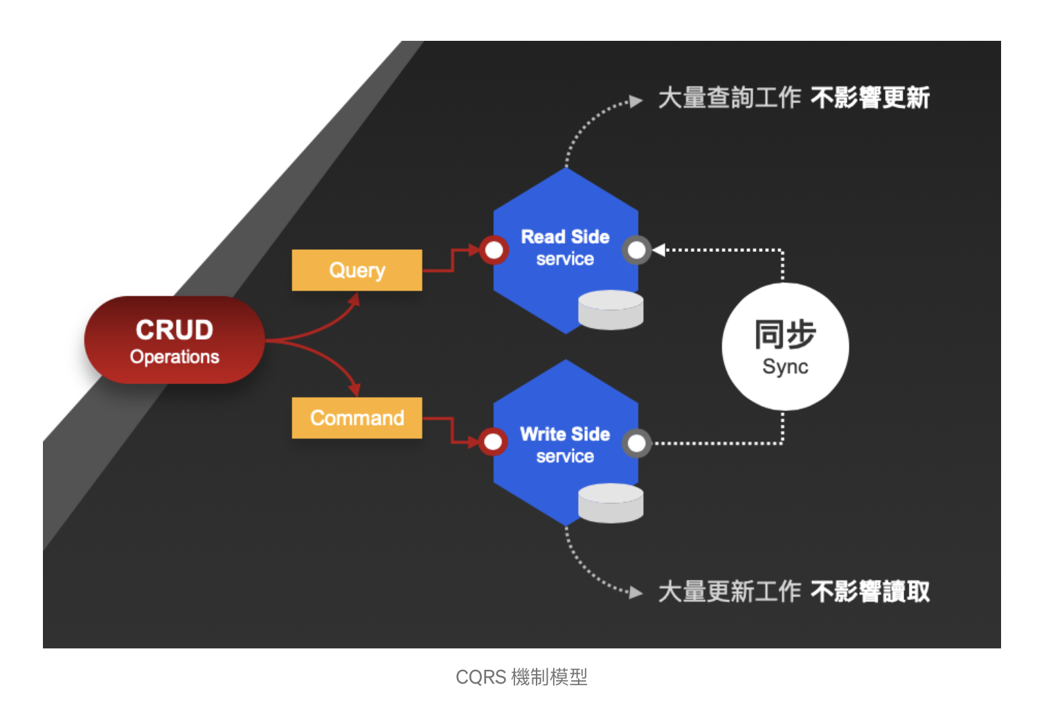

Slide 48
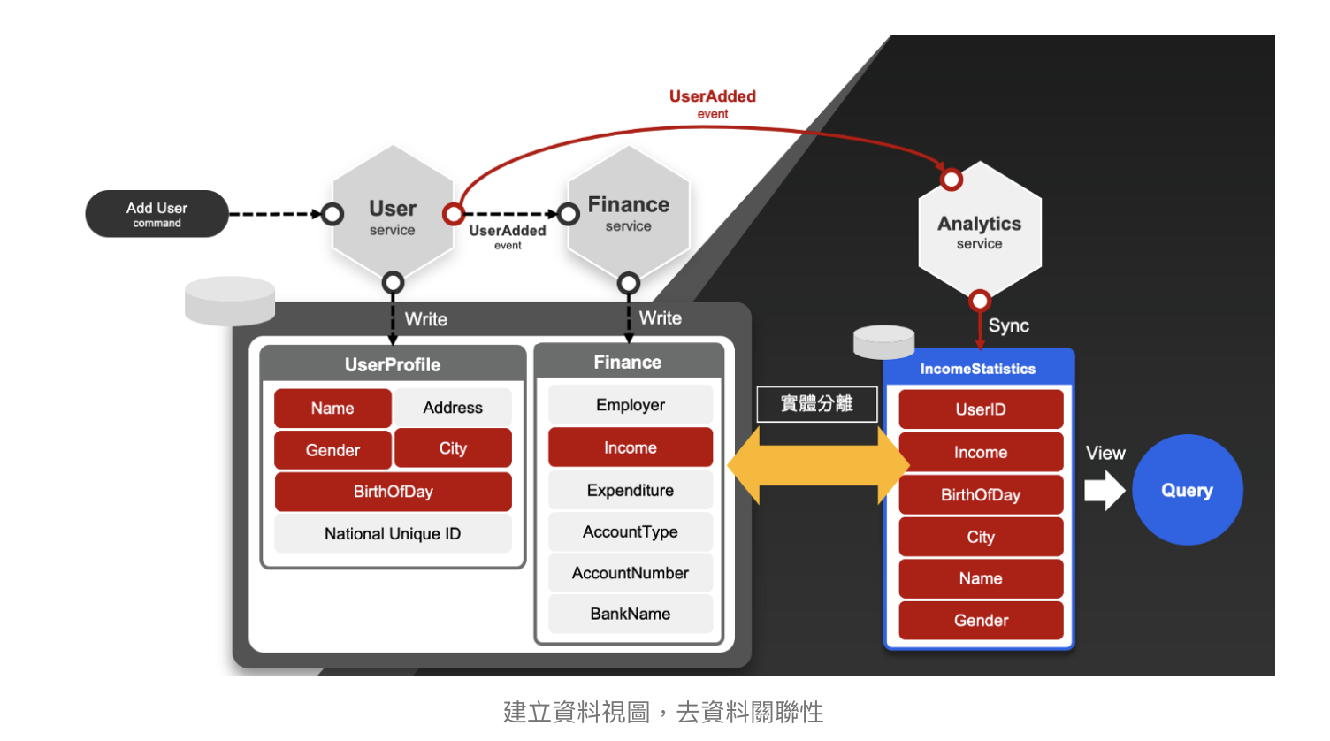
在應用層使用 CQRS 的主要好處，是可以利用 CQRS 的機制建立視圖（View），是一種提升資料查詢效能的主要手段，主要在於「避免關聯式查詢」的動作發生。我們可以將這種方法視為在資料被建立時，就已經預先進行了關聯動作，因此無需在查詢時進行複雜度高的關聯行為。有些人又稱這樣的做法稱作快取（Cache），但其實是同樣一件事。
由於資料之間的關聯性已經扁平化，成為一種視圖（View）的存在， 因此查詢和讀取將變成非常有效率。此外，因為新的視圖已經與原始資料庫實體分離，因此查詢工作也不會影響寫入工作的效能。如果你熟悉微服務架構設計的議題，這其實也是微服務架構中所說，重複大於重用的具體實現。
以 CQRS 所實現的視圖，與關聯式資料庫（RDBMS）所內建的視圖，其最大的不同在於，以 CQRS 所實現的視圖與原始資料可實體分離，甚至採用異質資料庫來存放。因為資料視圖的建立，是圍繞在業務需求，只要使用事件驅動，甚至可以彈性的創建各種樣態的視圖，而不影響既有資料庫效能。

Slide 49
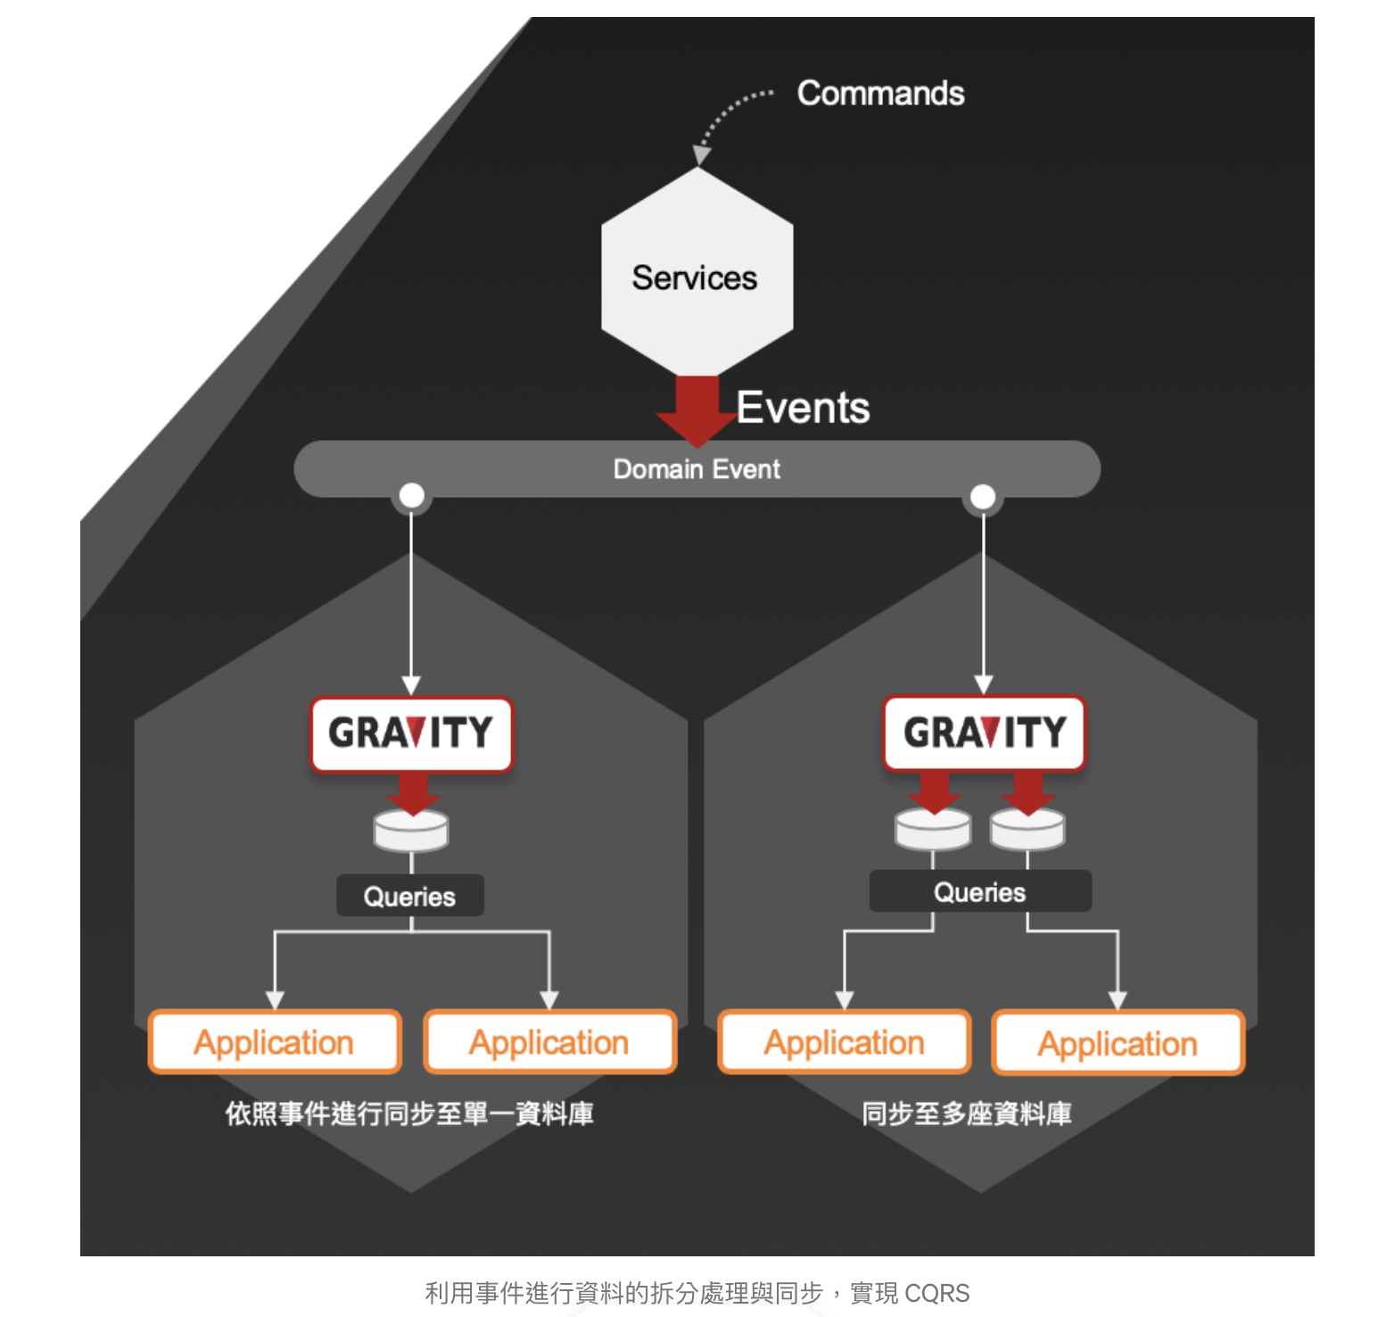
實現 CQRS 機制，多半採用的方法是使用事件驅動（Event-driven）來進行，這代表我們首先要搭建一套訊息佇列系統（Message Queuing System）來推送事件訊息。
實現「讀取端服務」時，就去監聽事件訊息，因為這些事件訊息即代表著資料的變更，就依照事件描述的資料變更，同步寫入到服務自己的資料庫中。
一旦某個服務接受了一個「命令」，執行了資料更新和寫入動作，會拋出一個「事件」，而讀取端服務或是對該資料有興趣的應用程式，就會接收事件並進行資料同步。
另外，多座資料庫的情形，其實也可以採用傳統 Replication 和 CDC 的作法，不過考量到這類「讀取端服務」的資料庫生命週期，往往等於服務的生命週期，其服務擴展和維護維運上，可能相較於應用層的做法，會比較沒有彈性。

Slide 50
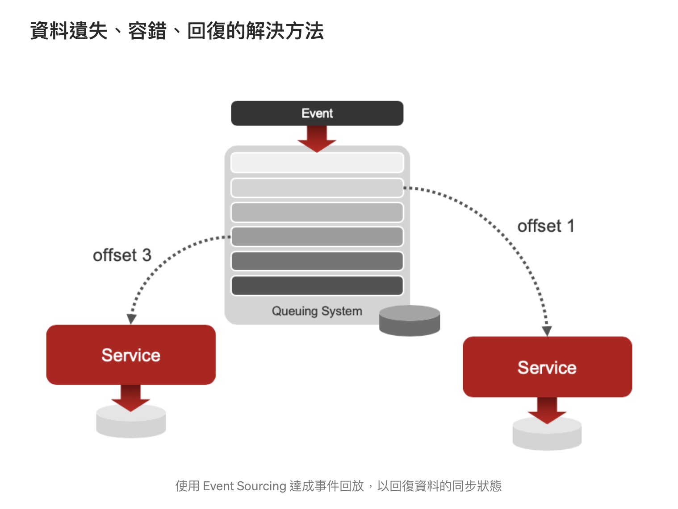
如果今天，我們的視圖資料不幸損毀，需要重頭同步並回復整個資料，又或是我們的讀取端服務突然中斷，導致事件遺失，該怎麼處理？這時，我們會採用 Event Sourcing 的方法實現事件回放，從特定時間點開始把事件回放，然後依照回放的事件內容執行同步工作。
為了實現 Event Sourcing 的機制，通常要仰賴日誌型（Log-based）的訊息佇列系統才能達成，例如：Kafka、NATS Streaming 等。這類訊息佇列系統，會將訊息照順序堆積儲存起來，並讓訊息消費者（Consumer）記錄自己最後讀取的位置（offset），並可以決定自己要從哪一個位置開始回放訊息。
運用這種回放機制，可以重新回復資料，也不用擔心事件遺失等問題。如果今天我們想要增加視圖的資料副本，也可以直接部署一個新的視圖服務，就可以從事件生成出一套完整的視圖資料庫。

Slide 51
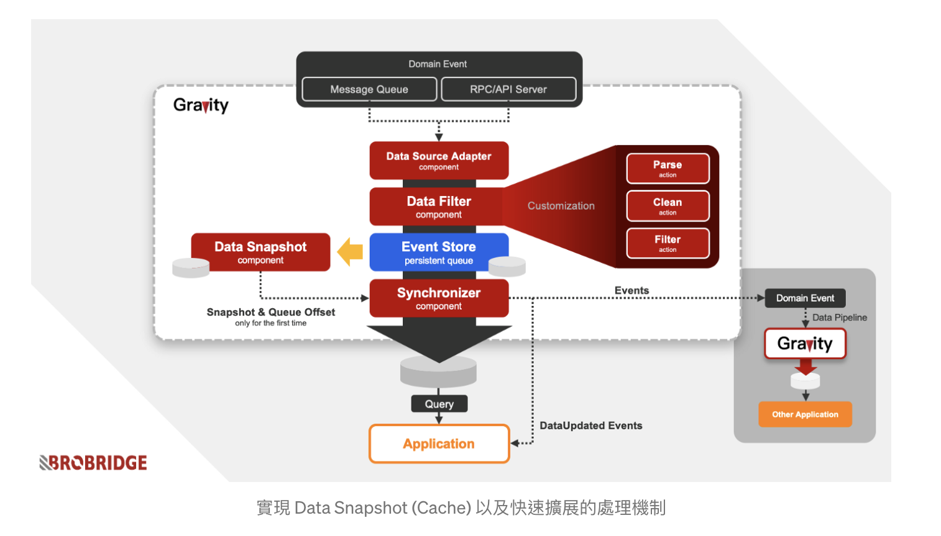
使用 Event Sourcing 來進行資料回復通常已經能解決大部分的問題，但問題是當事件非常多的時候怎麼辦？首先是訊息佇列系統可能有容量限制，不會無限度地存放所有訊息；再來是當訊息非常多，用回放方式來重建資料庫是一件耗時耗力、可能跑到天荒地老的工作。
這時，資料快照（Data Snapshot）或快取（Cache）就是一個需要被實現的機制，將資料庫最後的資料樣貌儲存一份，當我們在做服務擴展而要重建一個新的資料庫時，就可以從資料快照取得一份，並從該資料最後的事件位置繼續回放和接收同步。
當然，你也可以不準備資料快照，直接從既有正常的視圖服務資料庫中，直接用資料庫系統的 Replication 機制，或是寫程式去複製一份資料出來進行重建資料庫的工作。只不過，這樣會衝擊其中其中一個正在運行的服務效能。

Slide 52
降低與外部的訊息佇列系統的耦合程度
設計微服務架構時，服務間需要講求低耦合（Loose），而且要時時刻刻考慮單點故障（Single Point of Failure）的問題。這代表，我們的視圖服務，應該最大限度的與外界保持低耦合的狀態，而且當外部系統有問題，不該影響我們服務內的機制。
這問題的關鍵點在於過於中心化的訊息佇列系統，如果我們只有架一座訊息佇列系統，讓所有的服務共用，這代表除了實現正常的訊息傳遞之外，連 Event Sourcing 的工作（如：回放機制）壓力都在同一座訊息佇列。
導致每次回放領域事件（Domain Event），我們就會促使這個外部的訊息佇列系統，回放所有的事件， 衝擊效能。此外，假設這個外部的訊息佇列系統失效，也將會使我們的視圖服務的擴展和回復工作無法進行。
解決方法是在服務內部搭建一個獨立使用的訊息佇列系統，使外部系統無法直接影響服務的正常。

Slide 53
Cryptographic splitting
張麒仙

Slide 54
Data Storage on Cloud using Split-Merge and Hybrid Cryptographic Techniques (2022)

Slide 55
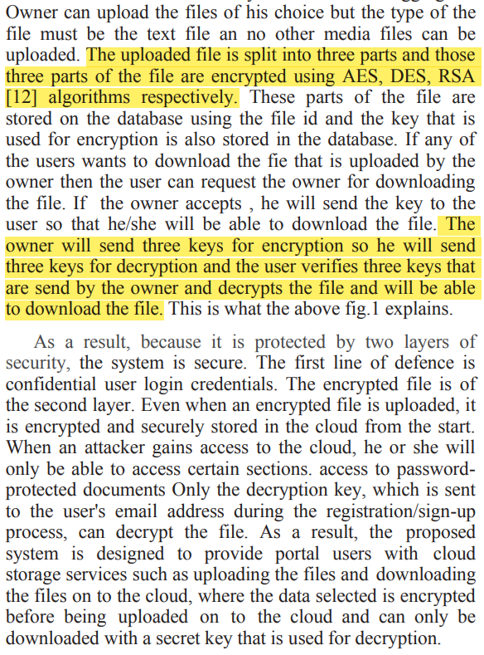
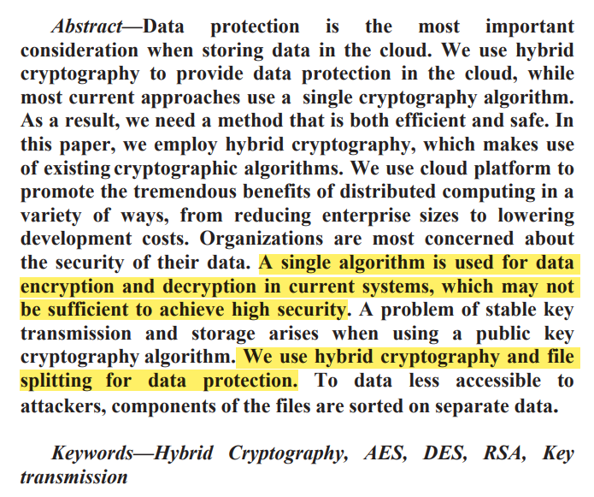

Slide 56
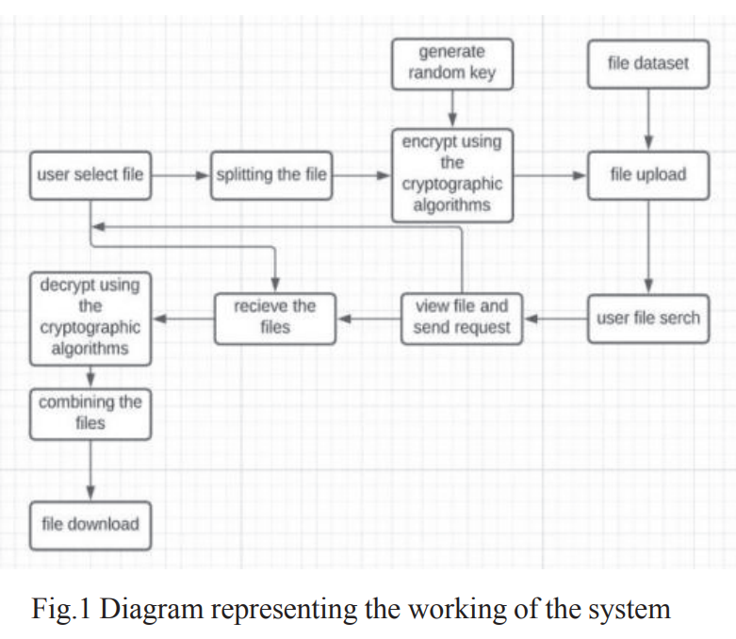
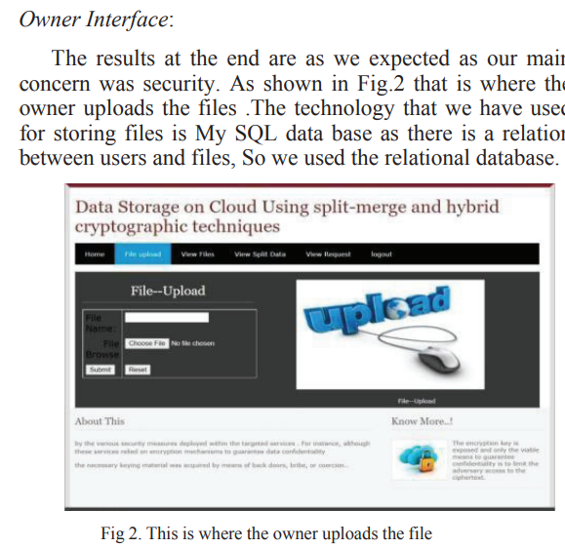

Slide 57
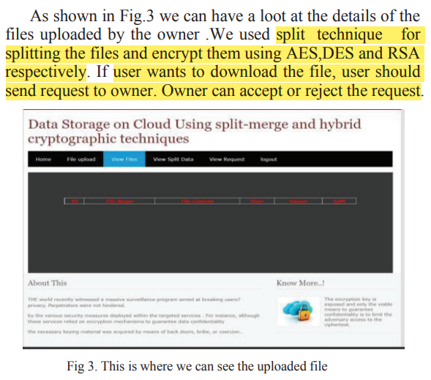
可以作為
期末報告的呈現方式
(Demo)

Slide 58
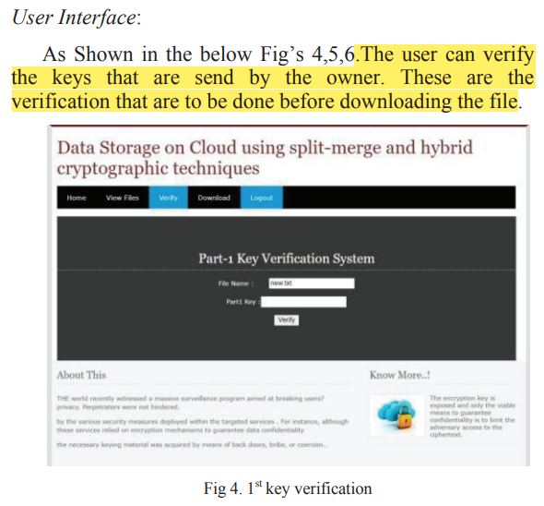
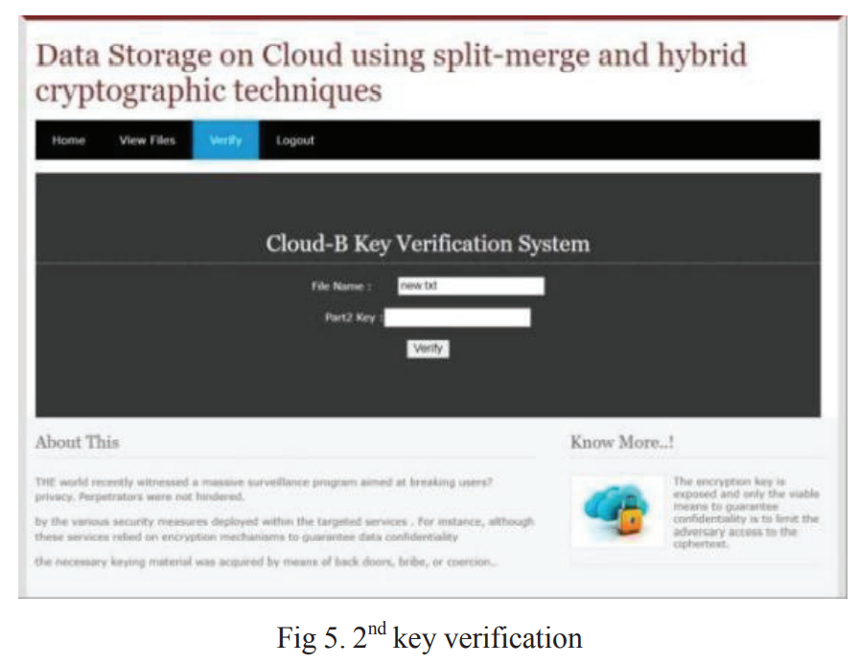
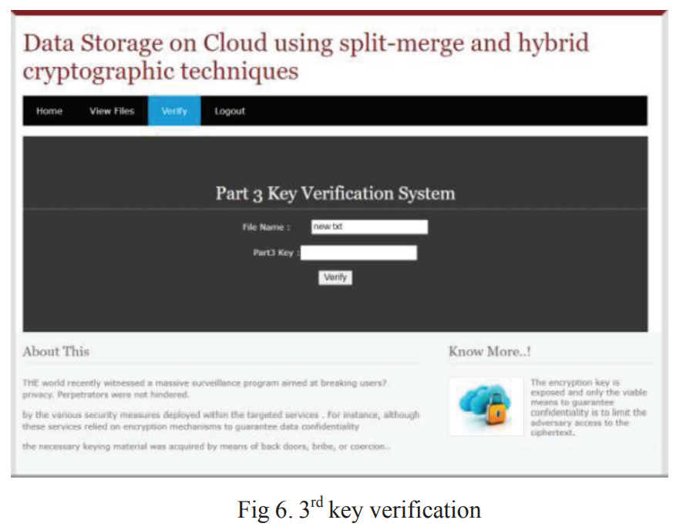

Slide 59
On cryptographic properties of cubic and splitting Boolean functions (2022)

Slide 60
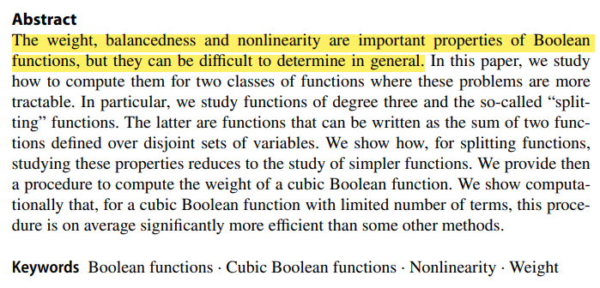
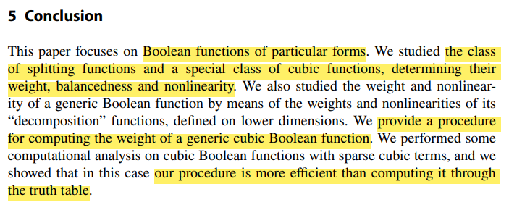
For more information, please visit https://youtu.be/kkMps3X_tEE

Slide 61
Reference
https://reader.elsevier.com/reader/sd/pii/S1574119215000942?token=AA955A938390A191EAFD131363252192D0FD80C53C73D8AA1FC32E92E3713C0992EC44BC0C6C87F6CB8B8F34381F9E72&originRegion=us-east-1&originCreation=20221114091852
http://journal.hmjournals.com/index.php/IJITC/article/view/522/825
https://ieeexplore.ieee.org/stamp/stamp.jsp?tp=&arnumber=9725841

Slide 62
Homomorphic encryption
蔡佳誠

Slide 63
Type

Slide 64
Three Types of Homomorphic Encryption
Partially Homomorphic Encryption (PHE)：A defined operation can be performed infinite times on the ciphertext. -> addition 或 multiplication 其中一個可以執行有限次數
Somewhat Homomorphic Encryption (SWHE)：A limited number of addition or multiplication operations are allowed. -> addition 及 multiplication 可以被執行有限次數
Fully Homomorphic Encryption (FHE)：An infinite number of additions or multiplications for ciphertexts is enabled. -> addition 和 multiplication 皆可以執行無限次數

Slide 65
Three Types of Homomorphic Encryption
Partially Homomorphic Encryption (PHE)：RSA、GM、ElGamal、Paillier
Somewhat Homomorphic Encryption (SWHE)：BGN
Fully Homomorphic Encryption (FHE)：Gentry、BFV、BGV、CKKS → SEAL、HELib

Slide 66
Consideration
semantic security：給予一個ciphertext，完全無法得知任何plaintext的資訊。
chosen-plaintext attacks：一次丟好幾組的明文到演算法中，去觀查其密文的變化進而找到key

Slide 67
FHE

Slide 68
The First FHE
2009 by Craig Gentry
Fully Homomorphic Encryption Using Ideal Lattices
more and more FHE nowadays
Notes:
Fully Homomorphic Encryption Using Ideal Lattices：https://dl.acm.org/doi/pdf/10.1145/1536414.1536440

Slide 69
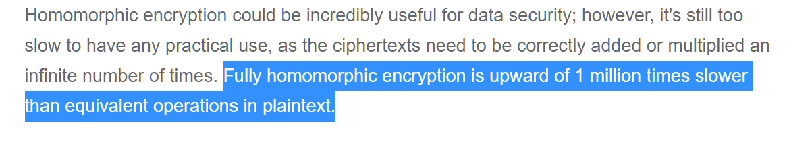
HELib
IBM
BGV Scheme
Speed
Notes:
homomorphic encryption：https://www.techtarget.com/searchsecurity/definition/homomorphic-encryption
IBM 重寫了其 C++ 同態加密庫 HElib，速度提高 75 倍 | 軟件推介：https://www.gushiciku.cn/dc_hk/105794856

Slide 70

HELib
A single operation that would take a plaintext operation one second would take this version of HElib 11-12 days to complete.
Notes:
homomorphic encryption：https://www.techtarget.com/searchsecurity/definition/homomorphic-encryption
IBM 重寫了其 C++ 同態加密庫 HElib，速度提高 75 倍 | 軟件推介：https://www.gushiciku.cn/dc_hk/105794856
GitHub：https://github.com/homenc/HElib

Slide 71
More About FHE
全同態加密發展與現狀的綜述：https://cccisa.ccisa.org.tw/article/viewFile/1944/1951

Slide 72
PHE

Slide 73
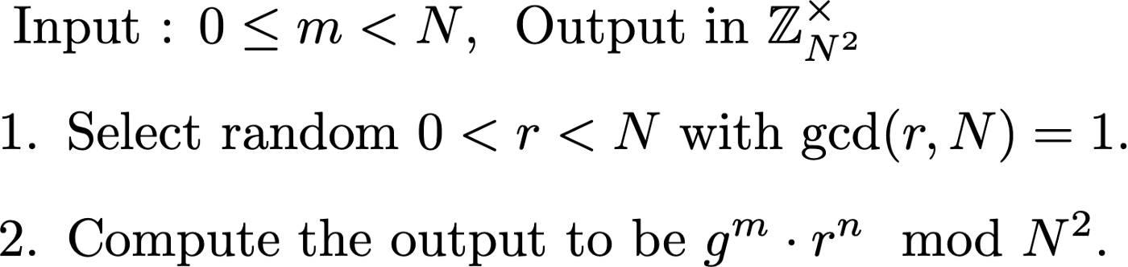
Paillier ecosystem
Notes:
同態加密 (Part 2：Paillier cryptosystem)：https://blog.amis.com/%E5%90%8C%E6%85%8B%E5%8A%A0%E5%AF%86-part-2-paillier-cryptosystem-bd96af29da0e

Slide 74
Paillier ecosystem
N 是由兩個大質數所相乘。但是常常實務上的應用時， message space 是在 0 到 某個質數 P 之間，甚至是更一般的合數
導致明明其實想在 message space 內做運算，但是當你使用了同態加密運算，但是隨著運算的次數變多，會發生產生了 “誤差” -> 加密跟解密後得到的東西不一樣
Notes:
同態加密 (Part 2：Paillier cryptosystem)：https://blog.amis.com/%E5%90%8C%E6%85%8B%E5%8A%A0%E5%AF%86-part-2-paillier-cryptosystem-bd96af29da0e

Slide 75
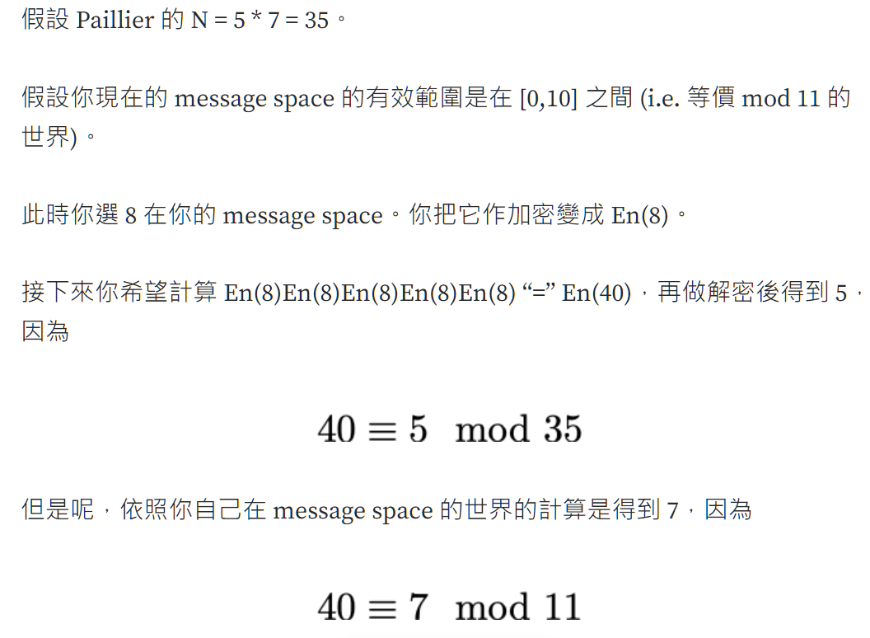
Paillier cryptosystem

Slide 76
SWHE

Slide 77
SWHE
FHE schemes have tremendous overhead

Slide 78
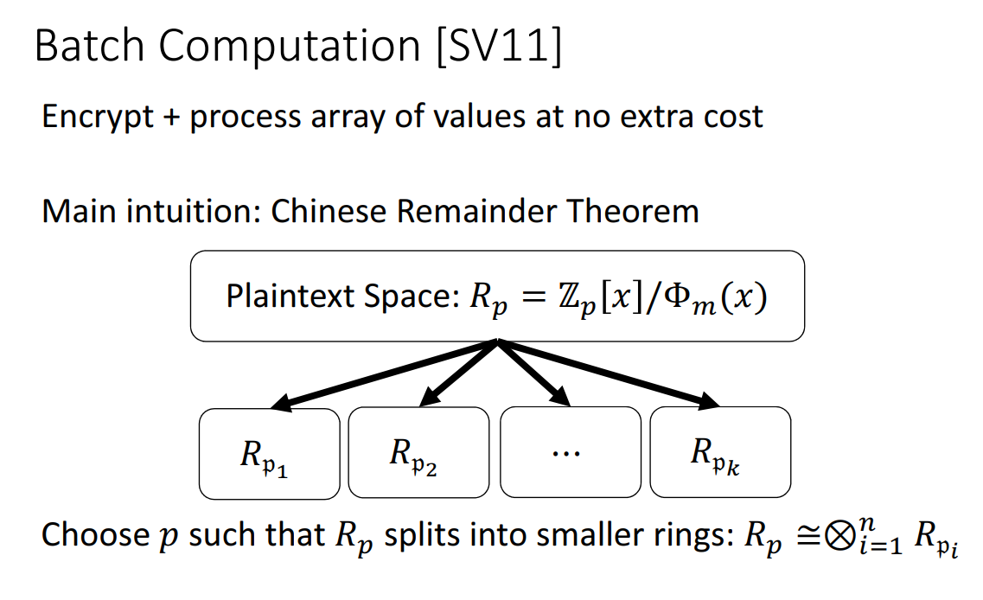
Batch

Slide 79
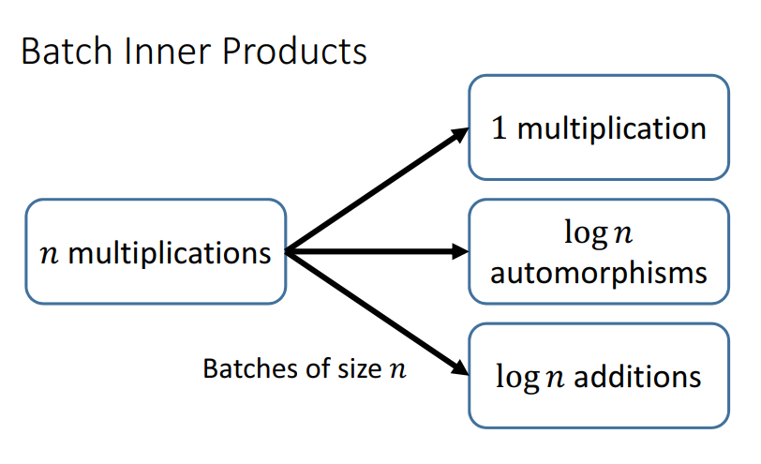
inner product

Slide 80
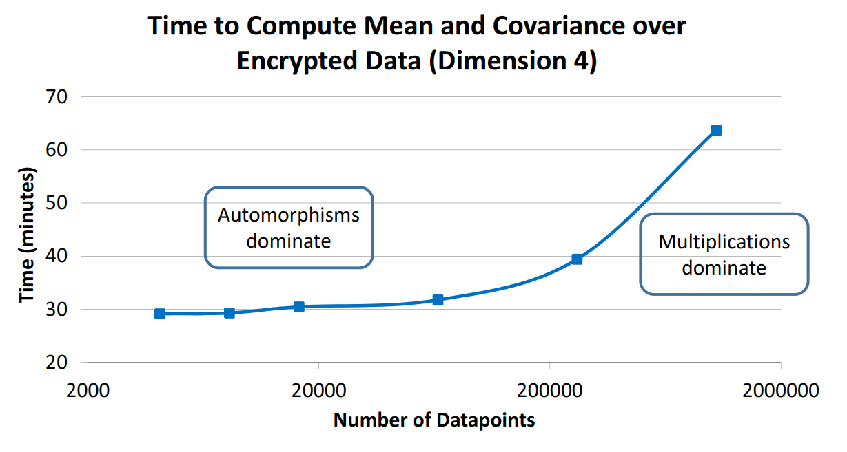
Performance

Slide 81
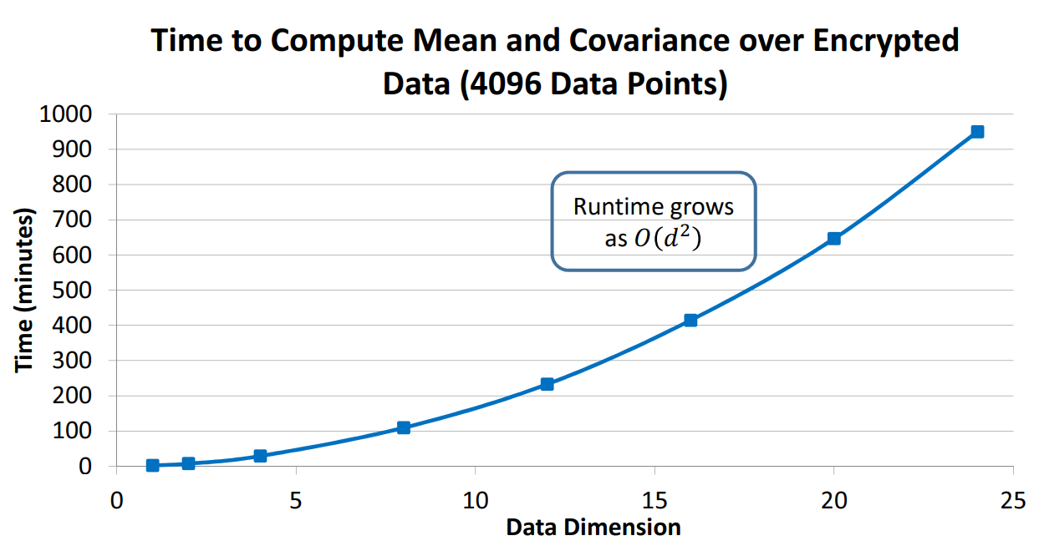
Performance

Slide 82
Implementation
GitHub：https://github.com/dwu4/fhe-si
paper：https://eprint.iacr.org/2012/078.pdf

Slide 83
Reference
https://ndltd.ncl.edu.tw/cgi-bin/gs32/gsweb.cgi?o=dnclcdr&s=id=%22104CCU00650008%22.&searchmode=basic#XXX
https://www.techtarget.com/searchsecurity/definition/homomorphic-encryption
https://blog.amis.com/%E5%90%8C%E6%85%8B%E5%8A%A0%E5%AF%86-part-1-%E7%B0%A1%E4%BB%8B-c46281304fd7
https://crypto.stanford.edu/craig/craig-thesis.pdf
https://cccisa.ccisa.org.tw/article/viewFile/1944/1951
https://dl.acm.org/doi/pdf/10.1145/1536414.1536440
https://link.springer.com/content/pdf/10.1007/3-540-48910-X_16.pdf
https://www.twblogs.net/a/61651cf11cf175147a0f222d
https://www.cs.utexas.edu/~dwu4/talks/SecurityLunch0214.pdf
https://blog.amis.com/%E5%90%8C%E6%85%8B%E5%8A%A0%E5%AF%86-part-2-paillier-cryptosystem-bd96af29da0e

Slide 84
Homomorphic encryption
霍芷媛

Slide 85
Partial homomorphic encryption

Slide 86
RSA
RSA is based on exponentiation: C = (m^x) (mod n) where m is the message and x is the secret key.
(a^n)(b^n)=(ab)^n
multiplying two ciphertexts encrypted with the same key is equivalent to raising the product of the plaintexts to the power of the secret key. Therefore, RSA is multiplicatively homomorphic.
https://www.keyfactor.com/blog/what-is-homomorphic-encryption/

Slide 87
2) phe 1.5.0
A Python 3 library implementing the Paillier Partially Homomorphic Encryption.
The homomorphic properties of the paillier crypto system are:
Encrypted numbers can be multiplied by a non encrypted scalar.
Encrypted numbers can be added together.
Encrypted numbers can be added to non encrypted scalars.
source distribution:https://pypi.org/project/phe/#files

Slide 88
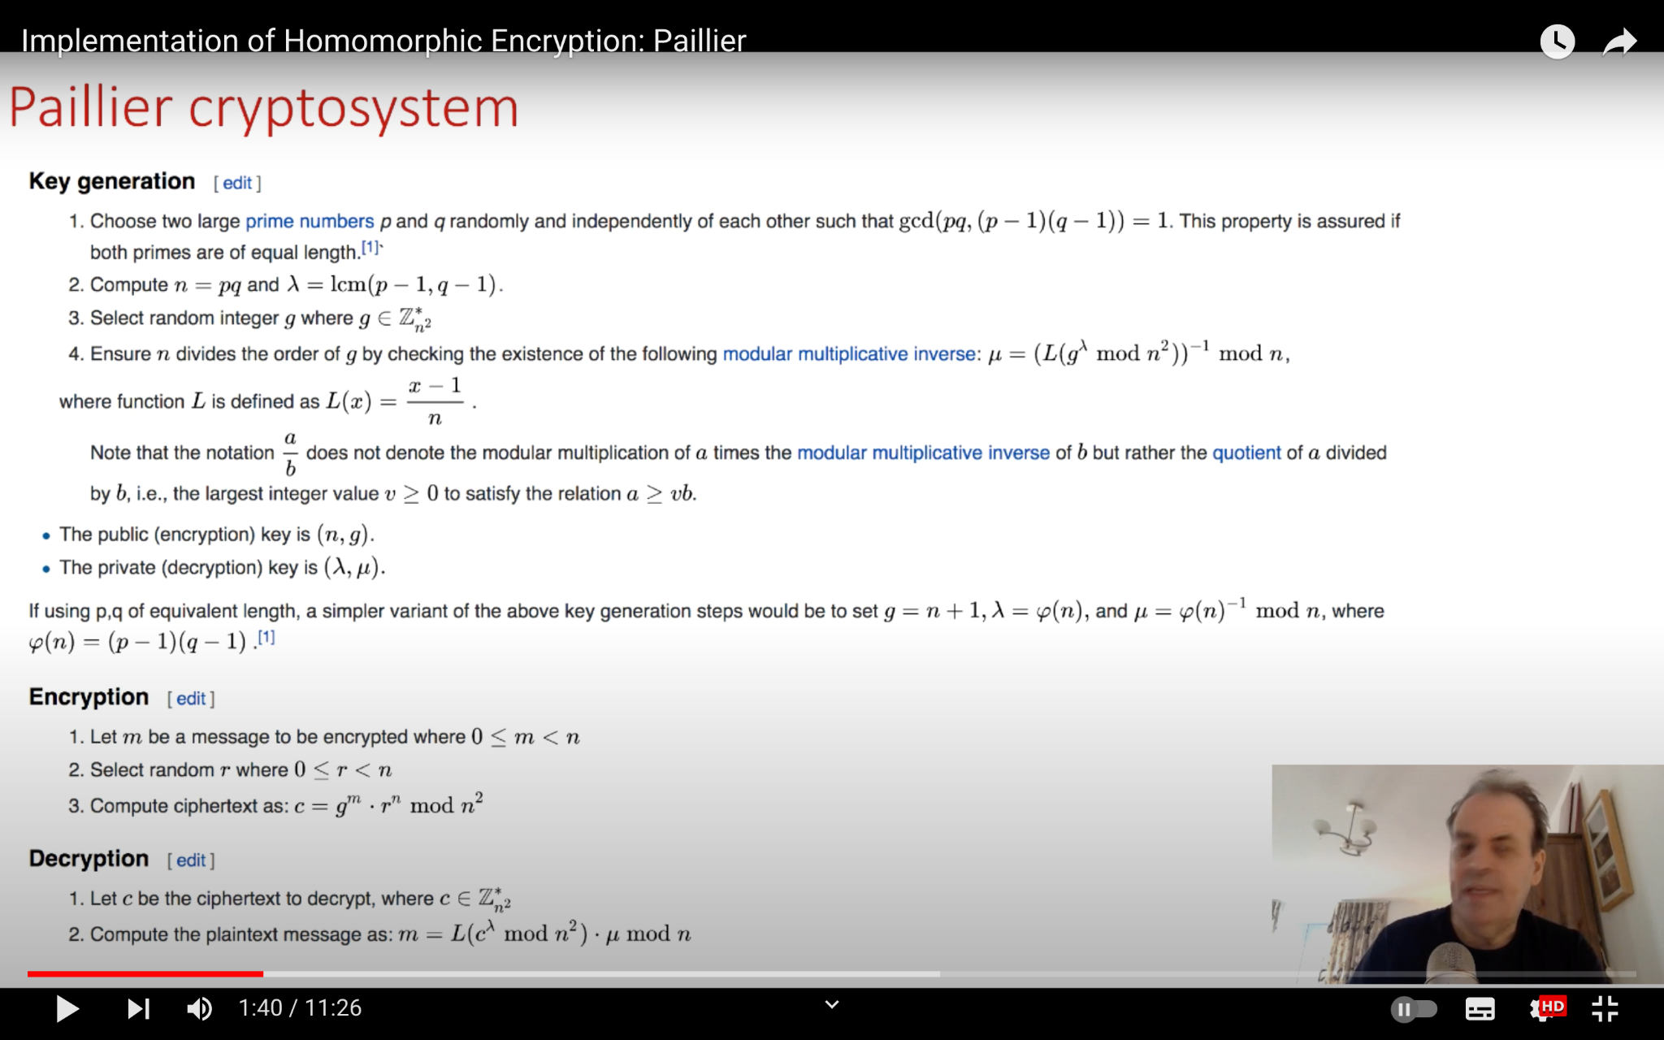
Notes:
https://www.youtube.com/watch?v=xHjhQZdP2aU

Slide 89
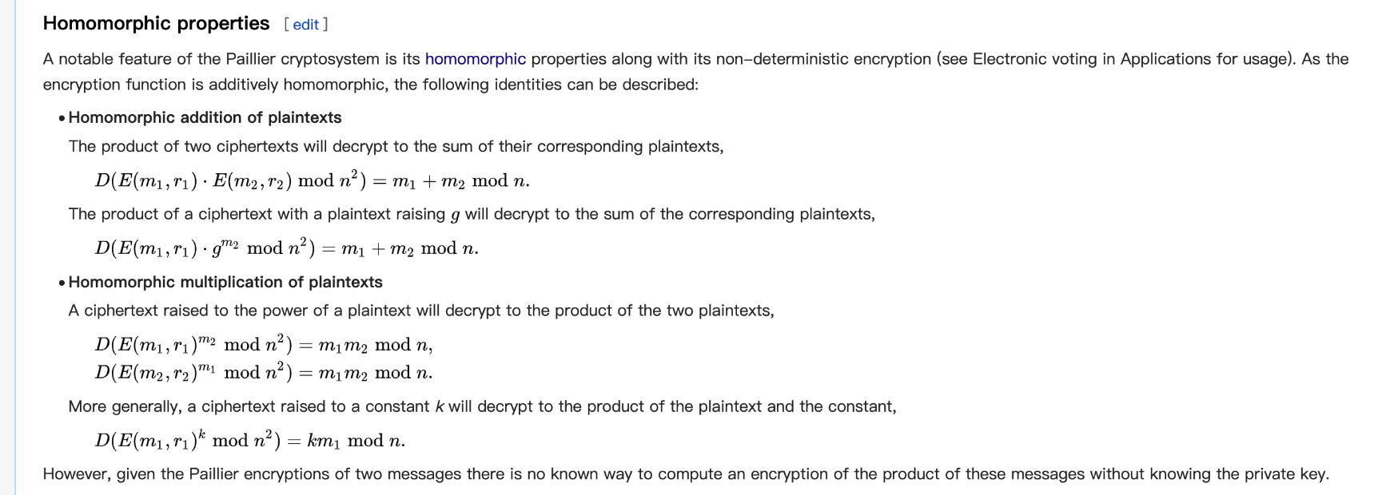

Slide 90
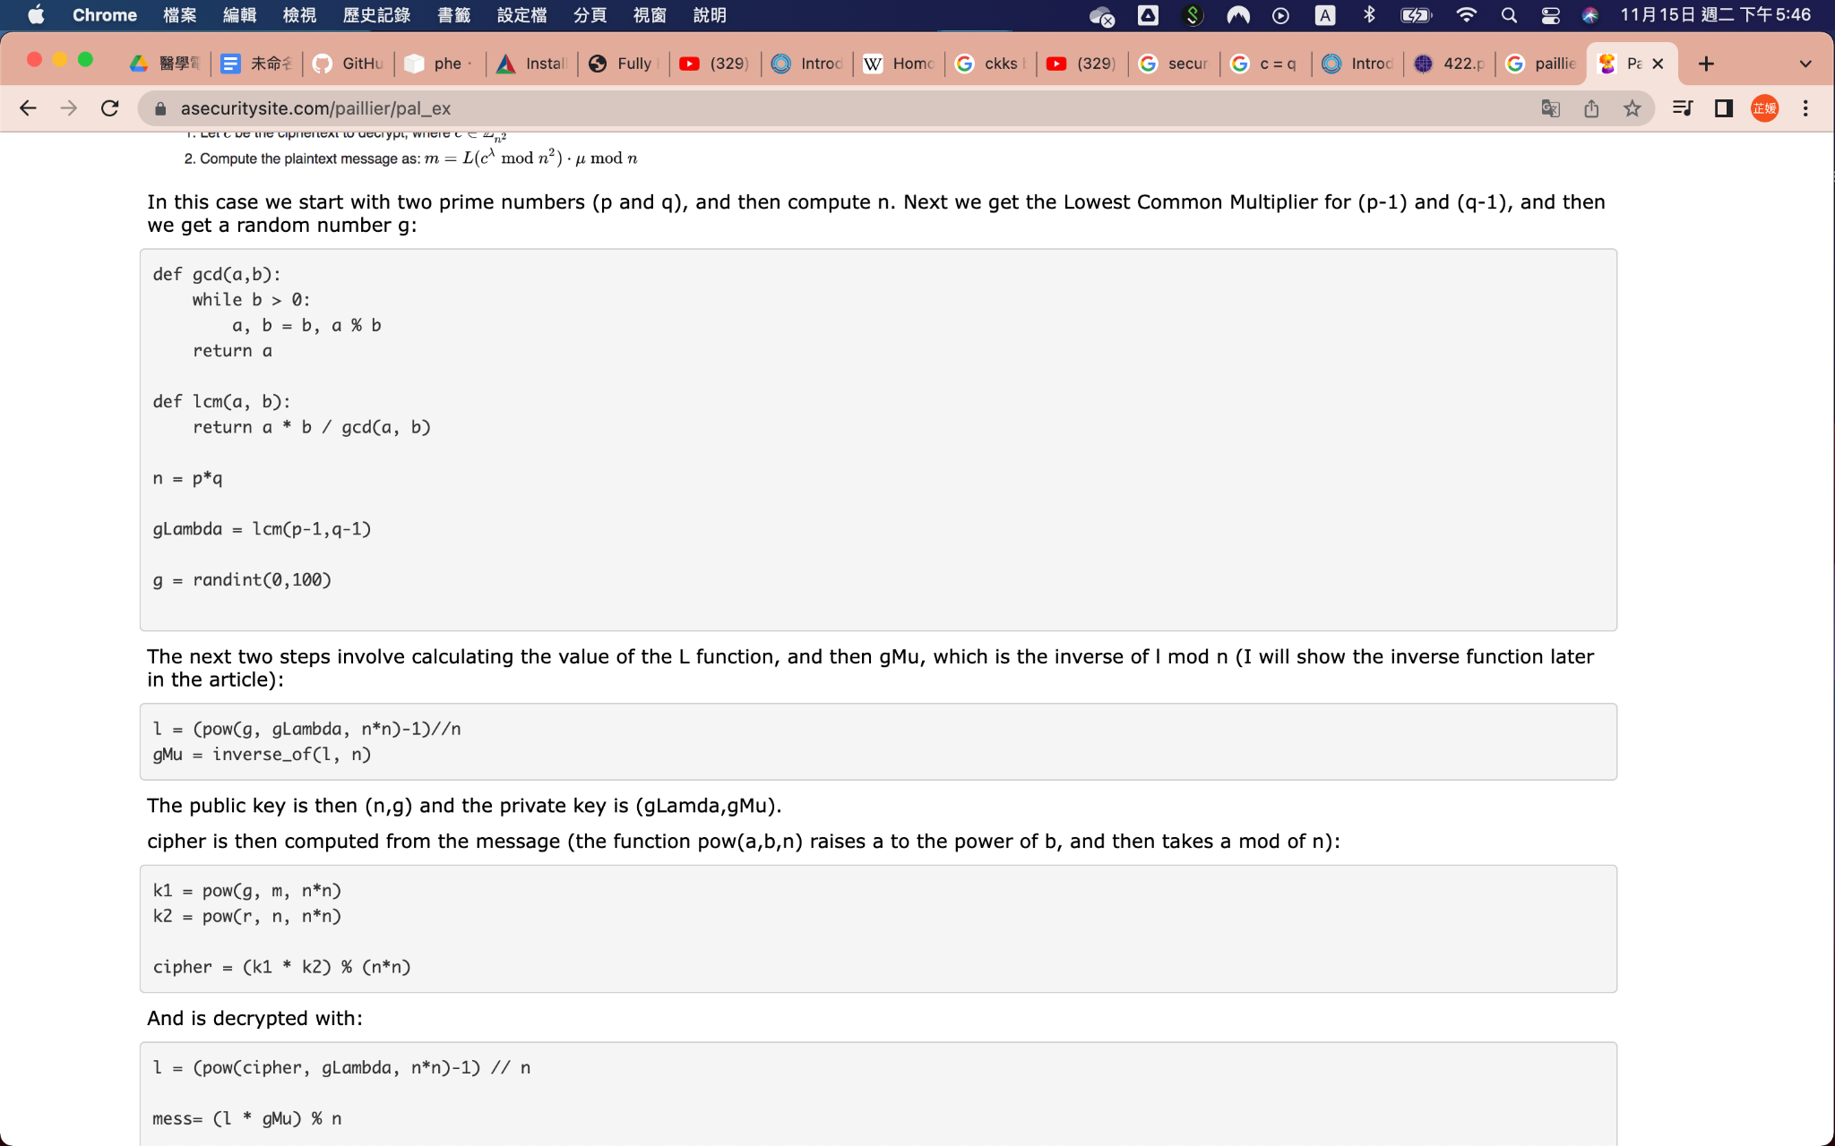
https://asecuritysite.com/paillier/pal_ex

Slide 91
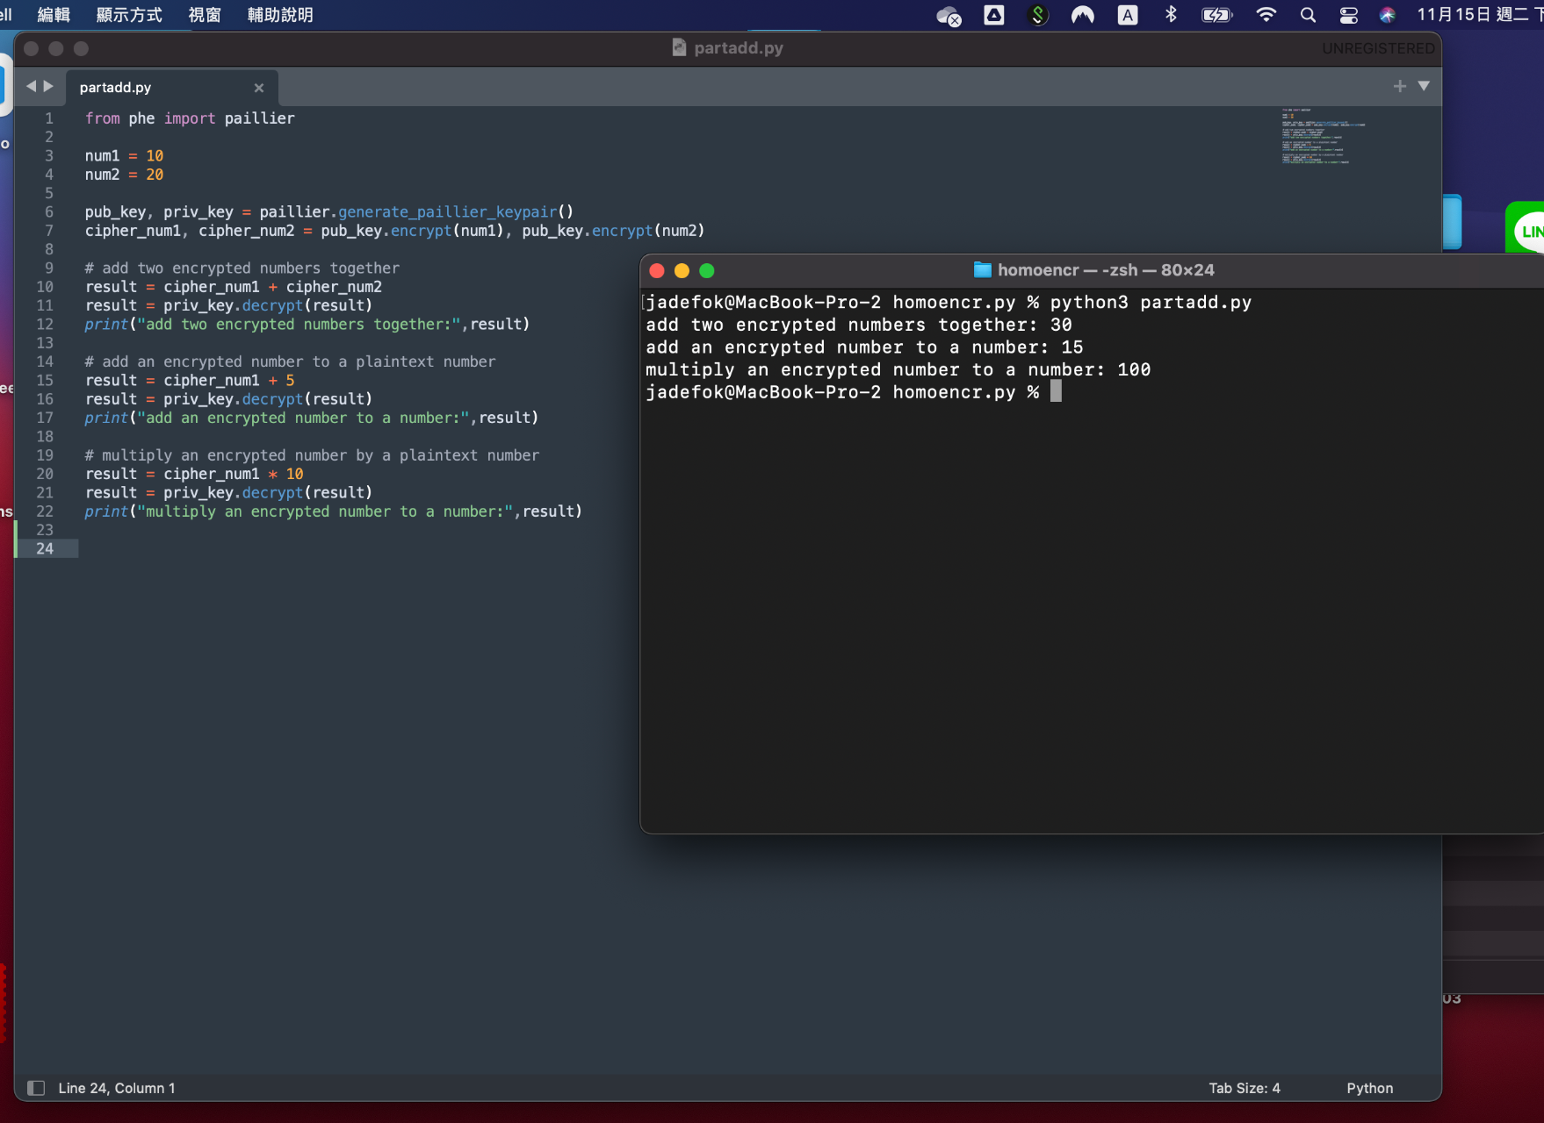

Slide 92
somewhat → fully

Slide 93
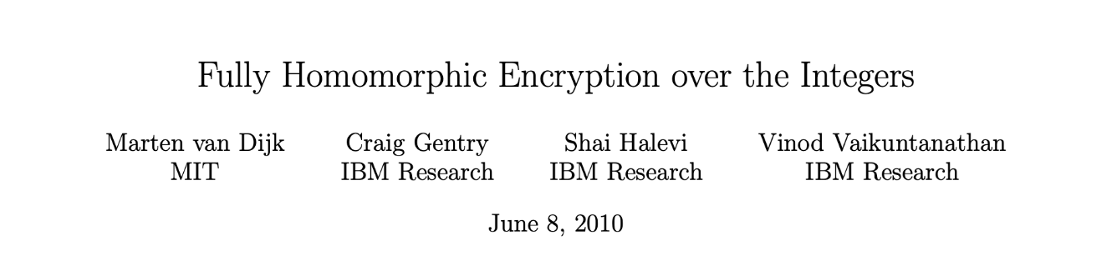
https://www.ntt-review.jp/archive/ntttechnical.php?contents=ntr201407fa5.pdf&mode=show_pdf
Fully Homomorphic Encryption over the Integers: From Theory to Practice
https://eprint.iacr.org/2009/616.ps

Slide 94


secret key is a relatively large odd integer p (of about 600 digits, say)
even random noise 2r (of 20 to 30 digits)
c = q p + 2r + m
the legitimate owner of the secret key p can decrypt the ciphertext c by computing the Euclidean division by p and checking the parity of the remainder 2r + m: it is even if m is 0 and odd if m is 1.

Slide 95
support XOR and AND GATE
the sum c1 + c2 = (q1 + q2)p + 2(r1 + r2) + (m1 + m2)
is an encryption of m1 XOR m2.
the product c1 c2 = (q1q2p + 2q1r2 + q1m2 + 2q2r1 + q2r1)p + 2(2r1r2 + r1m2 + r2m1) + m1m2
is an encryption of m1 AND m2.
The problem is that whenever a homomorphic XOR and especially AND operation is carried out, that noise value within the ciphertext grows (its size roughly doubles with each AND gate). If too many such homomorphic operations are carried out, at some point the noise value becomes larger than p, at which point it becomes impossible to ensure correct decryption anymore

Slide 96

bootstrapping (?)
he showed that by taking the decryption algorithm for his scheme and converting it into a circuit and passing the circuit a ciphertext and an encrypted version of the private key, what you would get out was a ciphertext of the same plaintext, but with the noise gone.
https://crypto.stackexchange.com/questions/42666/what-exactly-is-bootstrapping-in-fhe

Slide 97
Fully Homomorphic Encryption

Slide 98
Several open-source implementations of homomorphic encryption schemes exist today. Below is an incomplete list. If you would want to see your implementation being added, please contact us at contact@HomomorphicEncryption.org.
Microsoft SEAL: A widely used open source library from Microsoft that supports the BFV and the CKKS schemes.
OpenFHE: A widely-used open source library affiliated with NumFocus from a consortium of FHE developers that supports the major FHE schemes including BGV, BFV, CKKS, TFHE and FHEW, among others, with multiparty support.
PALISADE: A widely-used open source library from a consortium of DARPA-funded defense contractors that supports multiple homomorphic encryption schemes such as BGV, BFV, CKKS, TFHE and FHEW, among others, with multiparty support.
HELib: An early and widely used library from IBM that supports the CKKS and BGV scheme and bootstrapping.
FHEW / TFHE: Supports the TFHE scheme. (Please note that the FHEW and TFHE libraries are distinct from the FHEW and TFHE schemes which are also supported by other libraries listed on this page.)
HeaAn: This library implements the CKKS scheme with native support for fixed point approximate arithmetic.
Λ ○ λ (pronounced “L O L”): This is a Haskell library for ring-based lattice cryptography that supports FHE.
NFLlib: This library is an outgrowth of the European HEAT project to explore high-performance homomorphic encryption using low-level processor primitives.
HEAT: This library focuses on an API that bridges FV-NFLib and HeLIB.
HEAT: A HW accelerator implementation for FV-NFLlib.
cuHE: This library explores the use of GPGPUs to accelerate homomorphic encryption.
Lattigo: This is a lattice-based cryptographic library written in Go.
Concrete: This library supports a custom variant of the TFHE scheme.
EVA: A compiler and optimizer for the CKKS scheme (targeting Microsoft SEAL).

Slide 99
Homomorphic encryption
張麒仙

Slide 100
A systematic review of homomorphic encryption and its contributions in healthcare industry (2022)

Slide 101

For more information, please visit https://youtu.be/kkMps3X_tEE

Slide 102


Slide 103


Slide 104


Slide 105


Slide 106


Slide 107


Slide 108


Slide 109


Slide 110


Slide 111


Slide 112



Slide 113
Reference
https://link.springer.com/content/pdf/10.1155/2007/13801.pdf
A systematic review of homomorphic encryption and its contributions in healthcare industry

